Slide 1
Working material for this workshop
Single_read.fastq
Bacteria_GATTACA_L001_R1_001.fastq
Adapter_Sequence.fasta
rDNA_sequence.fasta
rDNA.gtf
all_steps.sh
Please register on Galaxy, activate account and login!
https://usegalaxy.org/login

Slide 2
Introduction to RNA-seq data analysis
Michela Traglia, Ayushi Agrawal
Bioinformatics Core, GIDB
October 14-15, 2021

Slide 3
Introductions
Reuben Thomas
Associate Core Director
Michela Traglia
Statistician III
Ayushi Agrawal
Bioinformatician II

Slide 4
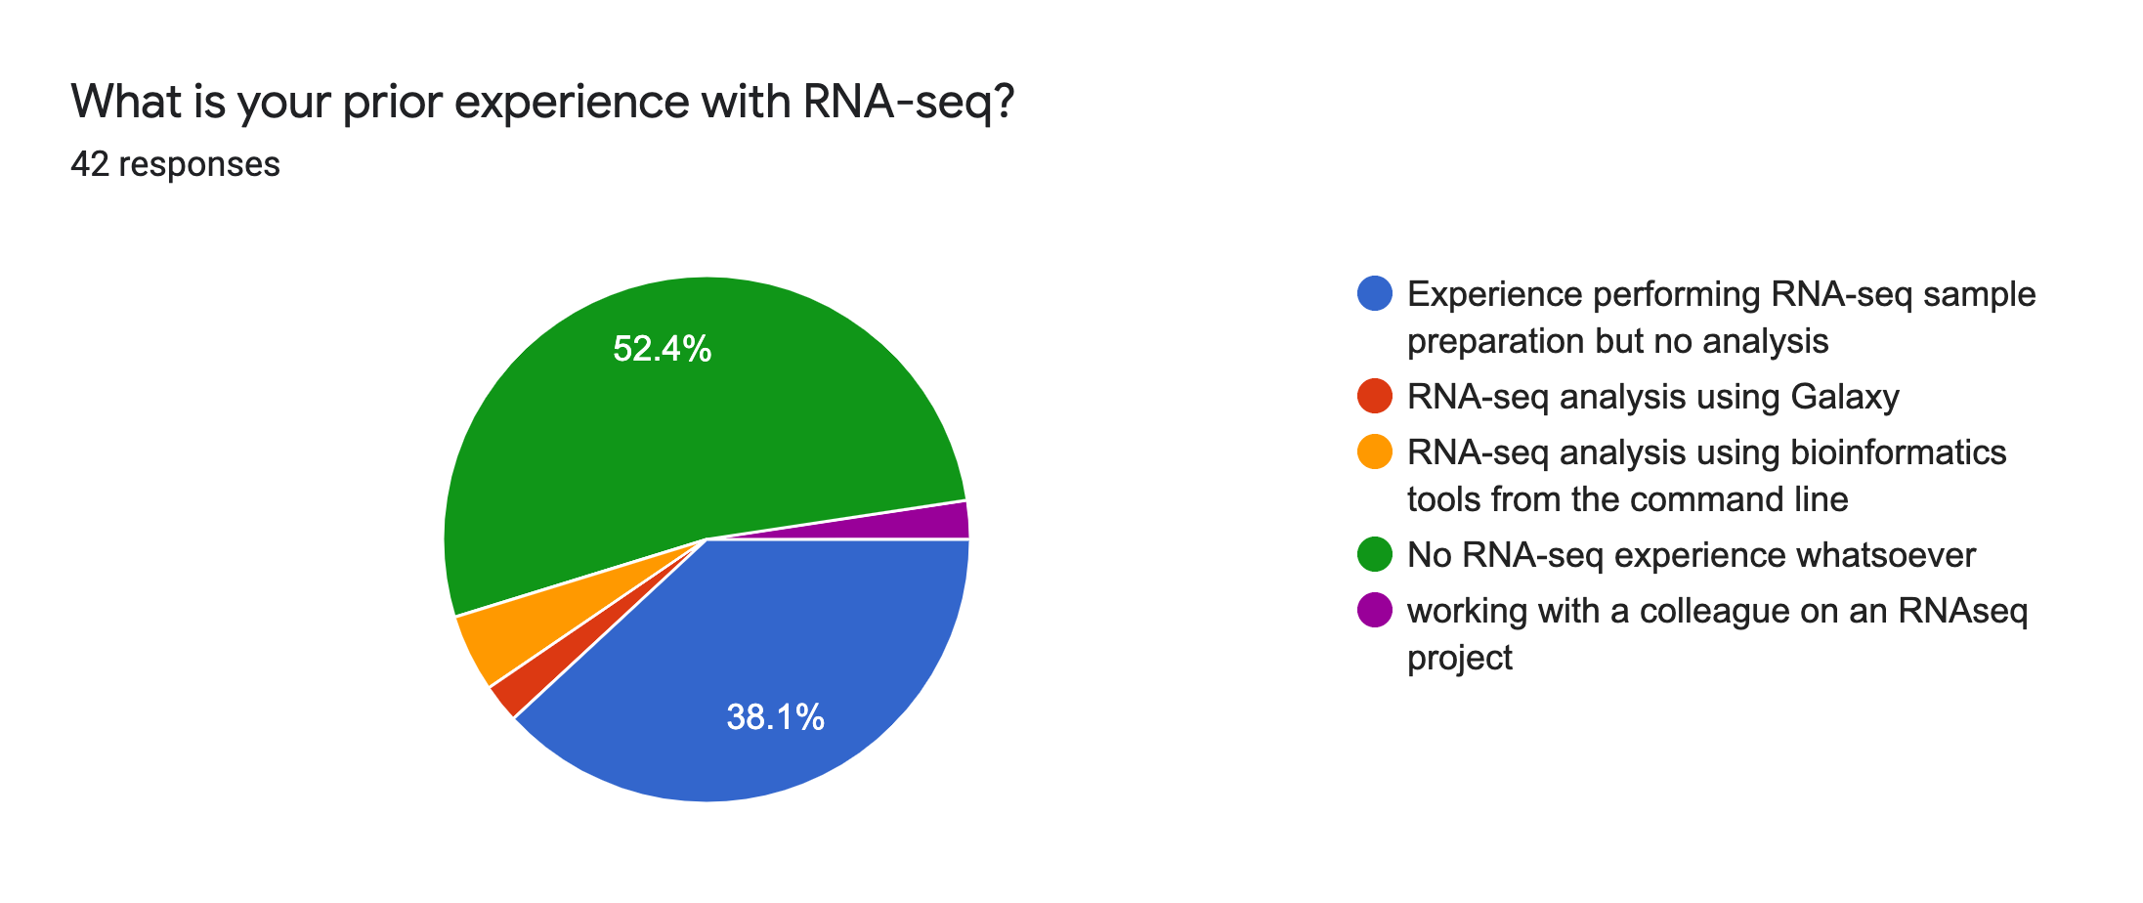
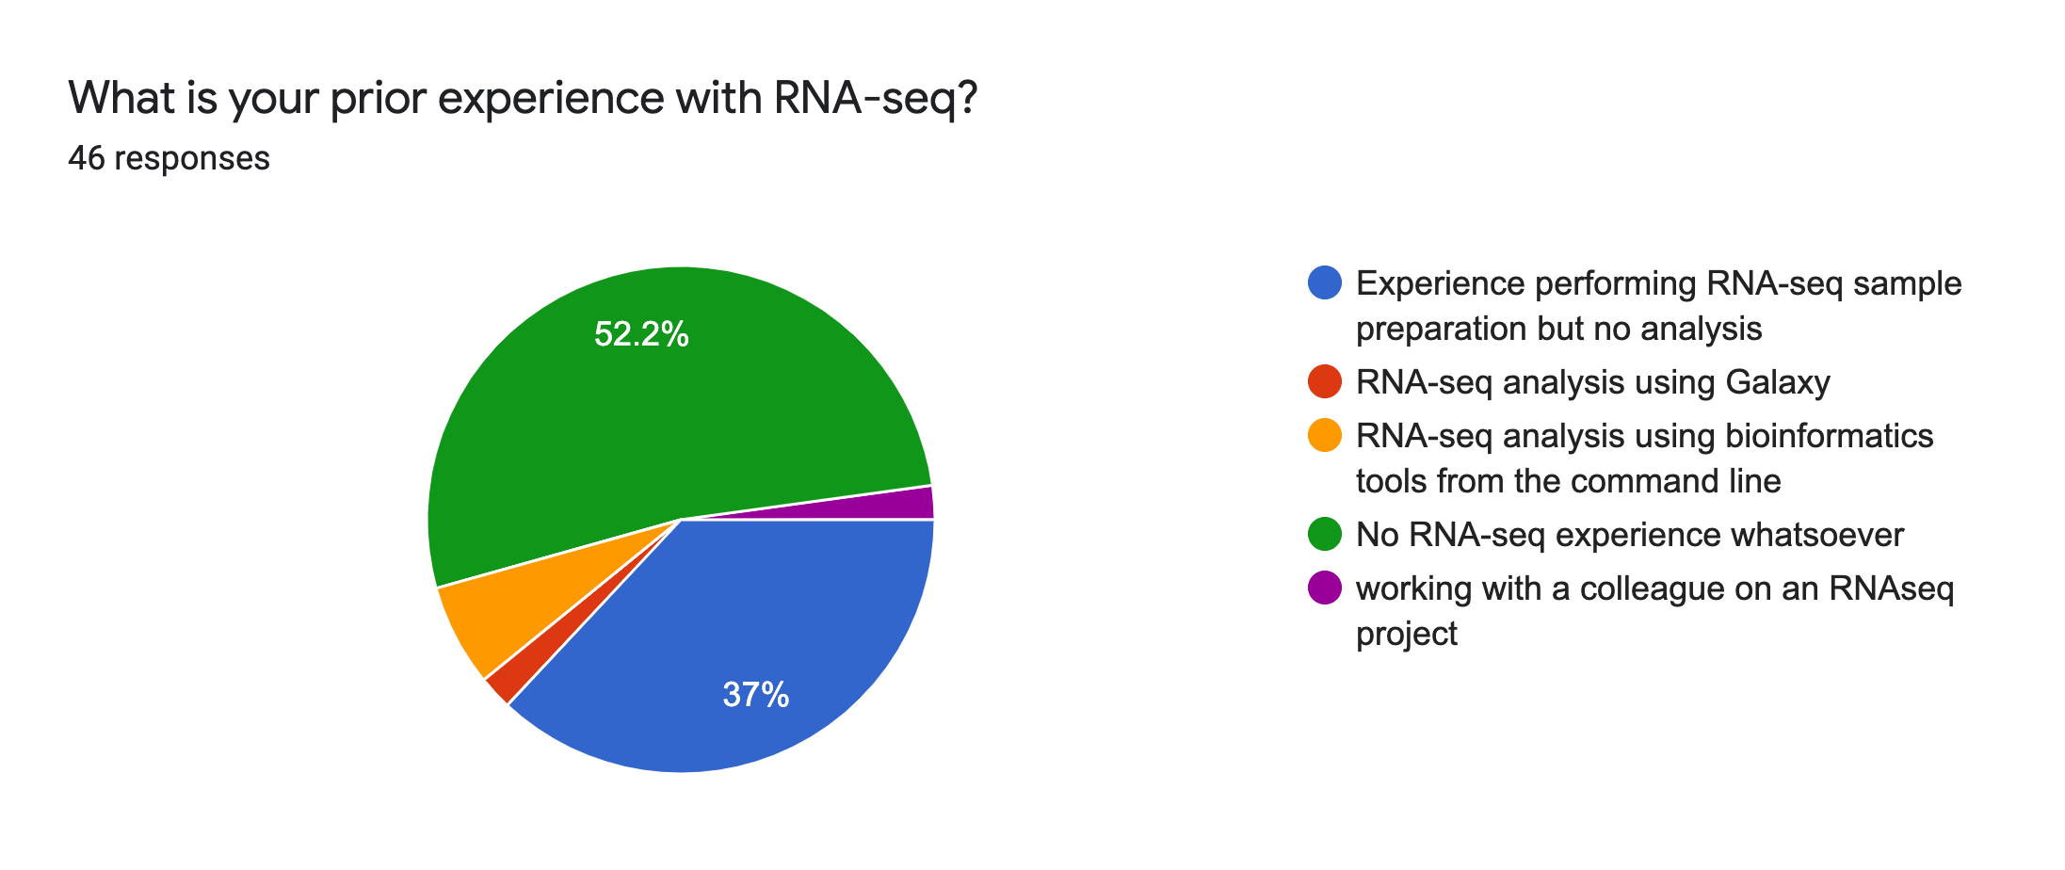
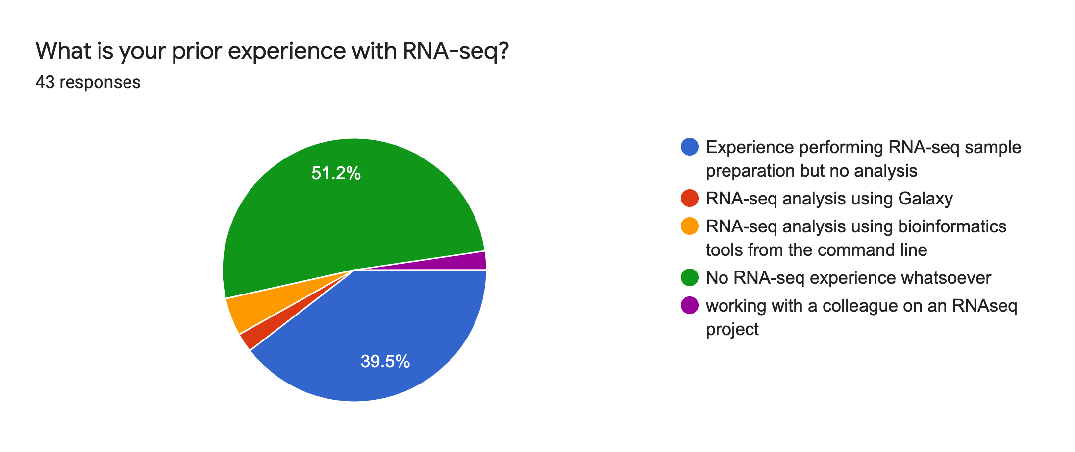
Expectations for the workshop

Slide 5
Goals
By the end of this workshop you should be able to:
Demystify each step of the RNA-Seq data analysis
Understand the bioinformatic pipeline from raw data
Enable informed conversations with computational biologists
Demonstrate how to analyze data using a graphical user interface (Galaxy)

Slide 6
Workshop outline
Session 1
Why studying the transcriptome and with which assay
Questions that we can answer with RNA-seq experiments
RNA-seq protocols in details
Break
Concepts and Demo with Galaxy: steps from raw data to FastQC
Session 2 (day2)
Concepts and Demo with Galaxy
From FastQC to Trimming
Mapping to reference genome
Break
Annotation to genomic features
Additional resources

Slide 7
Session 1
Tools: Galaxy and FASTQC

Slide 8
Motivation
Understanding the biological activities within the cell for interpreting the functional elements of the genome and understanding development and disease
Specific Questions
Find differentially expressed genes between two conditions (e.g. up and down-regulated genes in treated vs control mice or tumor vs healthy)
Discover and annotate new transcripts, splice variants, ncRNA
Notes:
annotate novel transcriptional events, e.g., exon skipping, alternative 3’ acceptor or 5’ donor sites, intron retention

Slide 9
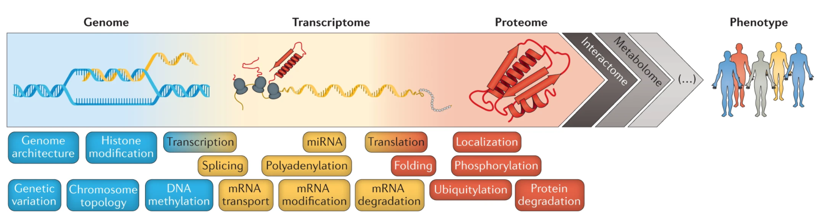
Gene expression connects genotype to phenotype
Environment
Diet, exercise, lifestyle, exposure
Figure: Buccitelli, C., Selbach, M. mRNAs, proteins and the emerging principles of gene expression control. Nat Rev Genet 21, 630–644 (2020)

Slide 10
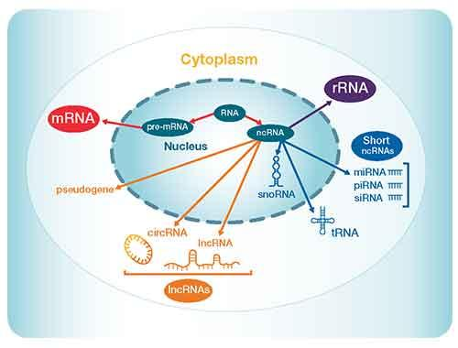
Transcriptome: RNA types
Notes:
For more details: https://www.thermofisher.com/us/en/home/life-science/sequencing/sequencing-learning-center/next-generation-sequencing-information/ngs-basics/rna-sequencing-methods.html

Slide 11
Experimental design is fundamental
Which biological questions we want to answer
Coding or non coding RNA?
Why do you expect to find differentially expressed genes in the particular tissue?
How many tissue types and/or time points to compare?
What types of genes do you expect to find differentially expressed?
What are the sources of variability from your samples?
More technical questions
Which sequencing platform?
Depth of sequencing?
Pooling samples?
Biological replicates/technical replicates?
Many others...
Introduction to Statistics and Experimental Design workshop
November 30, 2021
Please register!

Slide 12
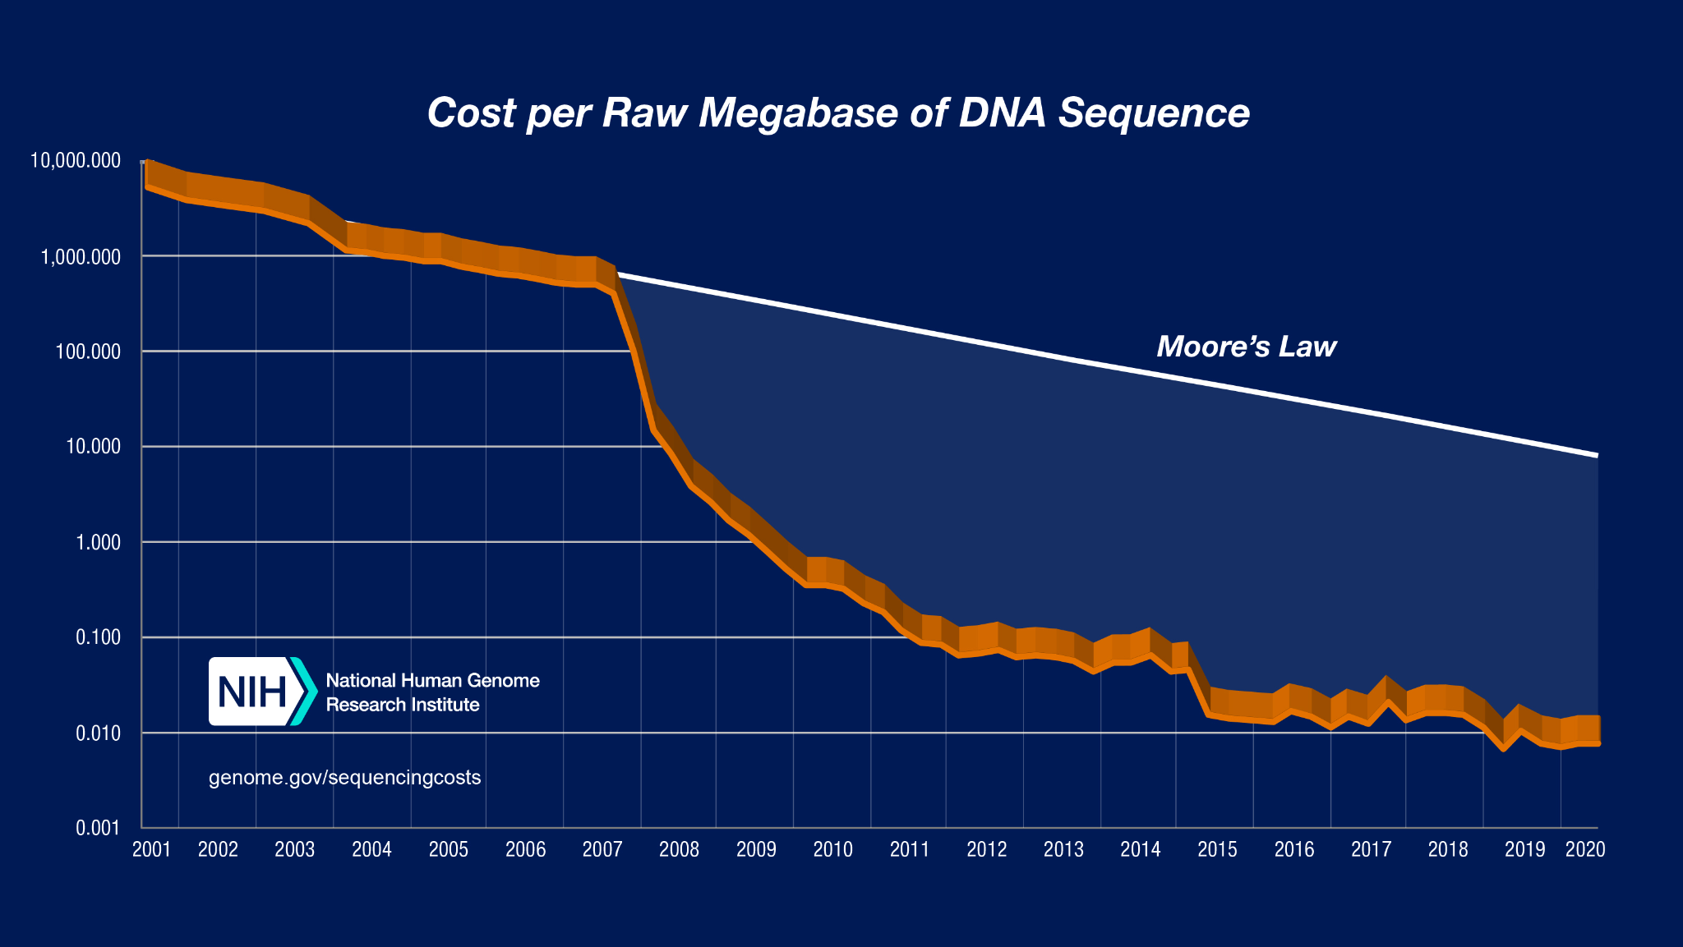
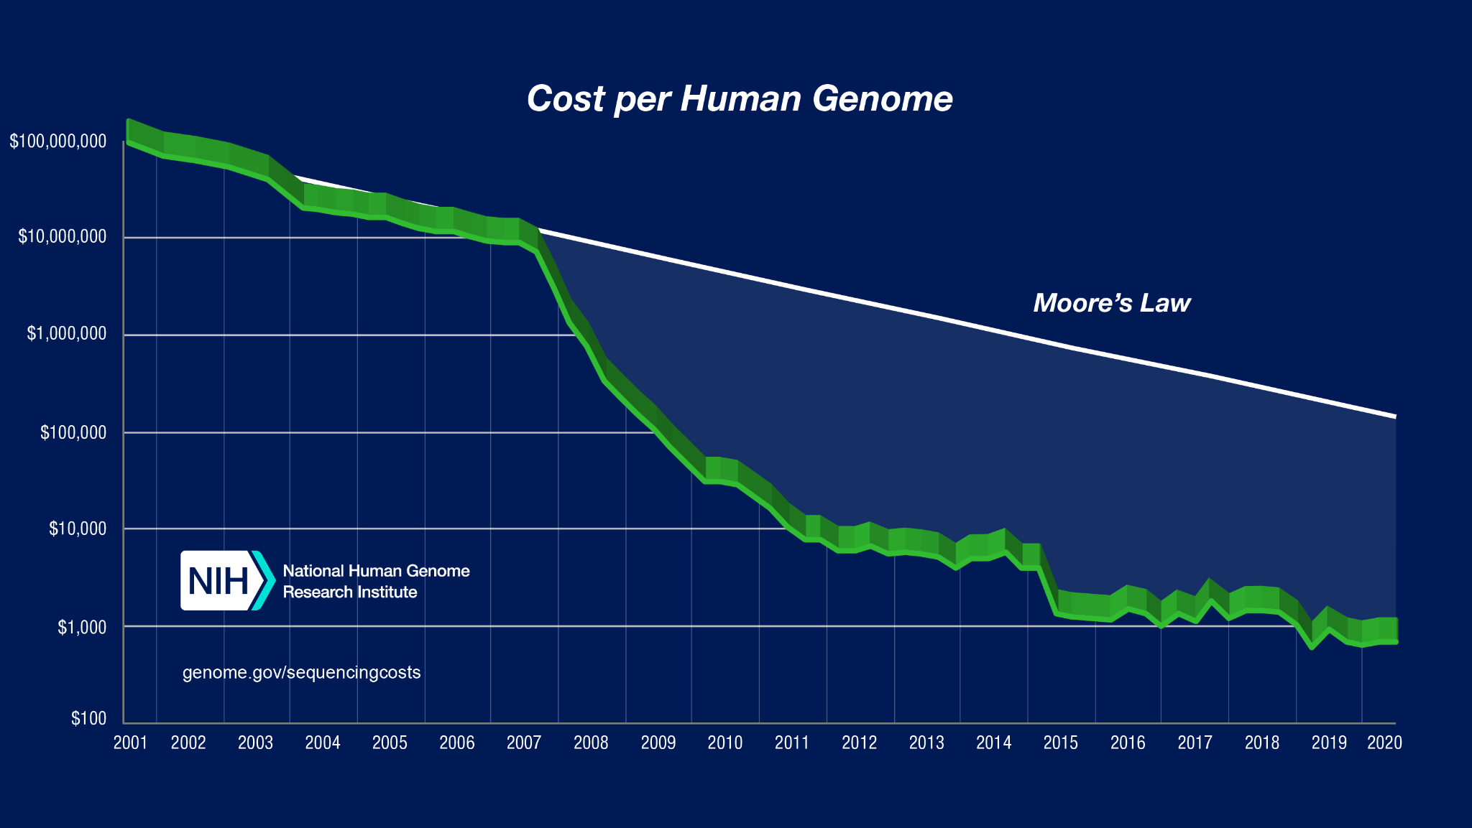
Sequencing studies - technology advance
High-throughput next-generation sequencing (NGS) technologies revolutionized genomic and transcriptomic studies
Notes:
Left plot: Cost per Megabase of DNA Sequence" - the cost of determining one megabase (Mb; a million bases) of DNA sequence of a specified quality
Right plot: Cost per genome data - August 2020
Source: https://www.genome.gov/about-genomics/fact-sheets/DNA-Sequencing-Costs-Data

Slide 13
RNA-seq – qualitative and quantitative biological insights
•Qualitative: identifying (annotating) or refining expressed transcripts, exon/intron boundaries, transcriptional start sites (TSS), and poly-A sites.
•Quantitative: measuring differences in expression, alternative splicing, alternative TSS, and alternative polyadenylation between two or more treatments or groups.
(i.e. experiment to measure differential gene expression - DGE)
https://rnaseq.uoregon.edu/#table1.1

Slide 14
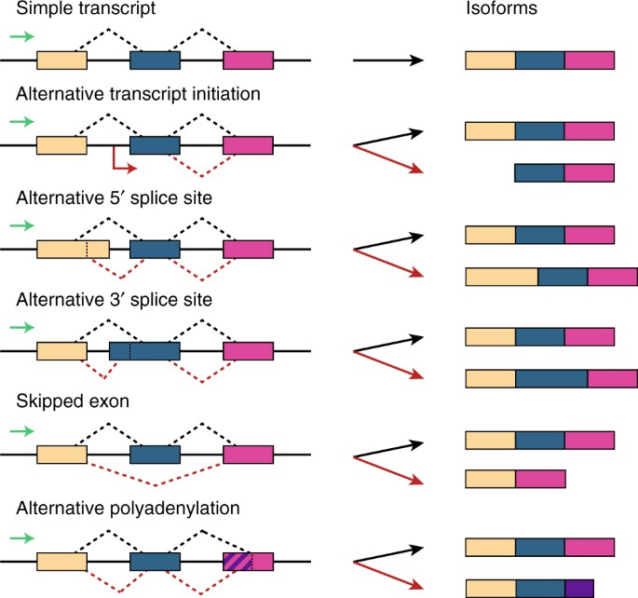
Protein isoforms

Slide 15
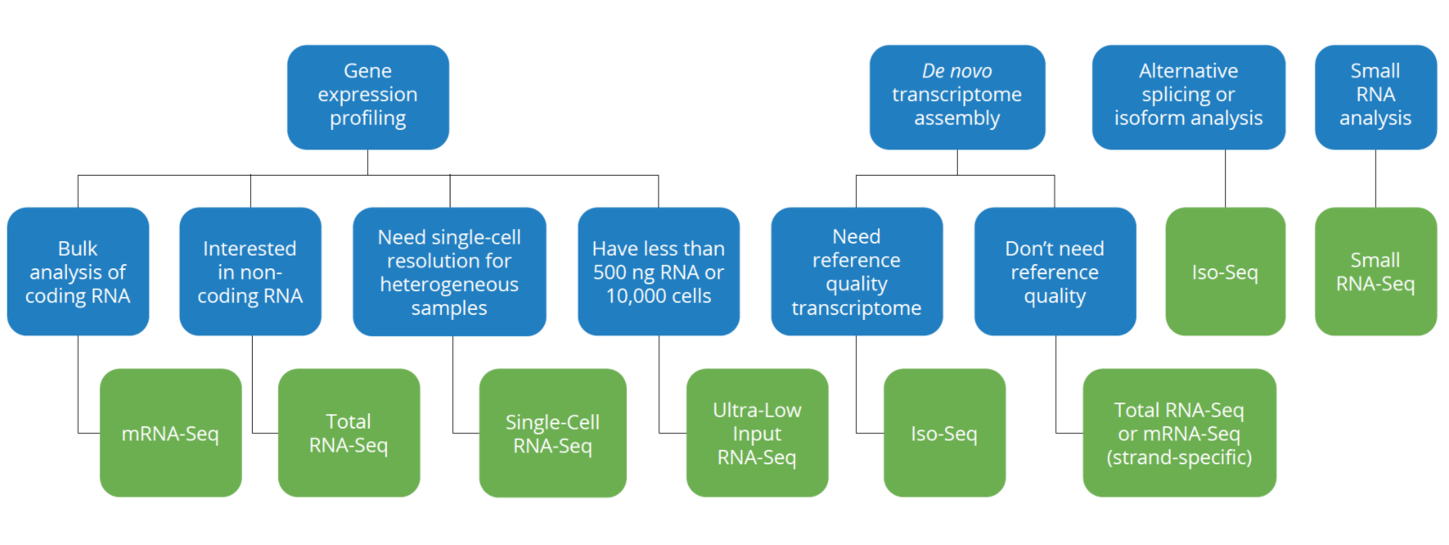
Which RNA-seq assay should I use?
From: Genewiz

Slide 16
Bulk RNA-seq - advantages and limitations
A major breakthrough - replaced microarrays
Measures the average expression level for each gene across a large population of input cells
To quantify expression signatures in disease studies
Insufficient for studying heterogeneous or dynamic systems, e.g. early development studies, complex tissues (brain)

Slide 17
scRNA-seq - advantages and limitations
First publication by (Tang et al. 2009)
From ~2014 new protocols and lower sequencing costs made it more accessible
Measures the distribution of expression levels for each gene across a population of cells
Allows cell type identification, studying the heterogeneity of cell responses
Currently there are several different protocols in use and commercial platforms available
Still expensive, not a gold standard as RNA-seq, small amount of material, uncertainty

Slide 18
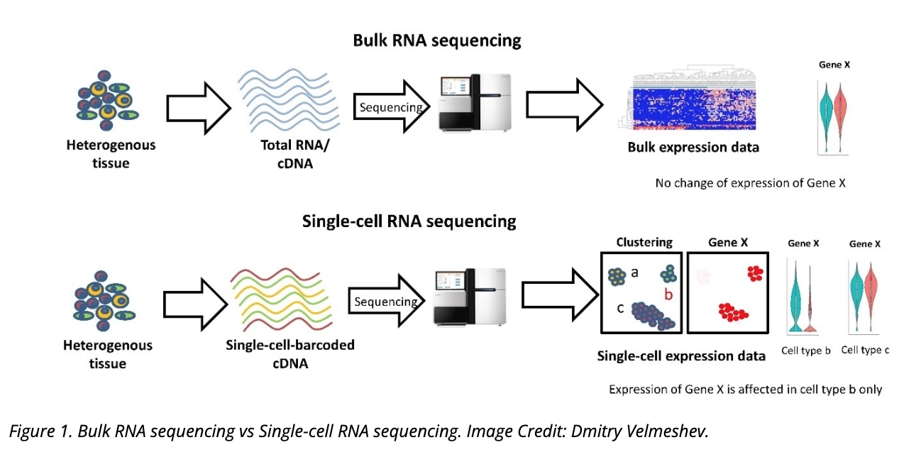
Bulk RNA-seq vs single cell (sc) RNA-seq
Single Cell RNA-seq workshop
October 22-26, 2021
Please register!
From: https://www.technologynetworks.com/genomics/articles/recent-advances-in-single-cell-genomics-techniques-324695
Notes:
There is another new technology called spatial transcriptomics which is somewhere in the middle of RNA-seq and single-cell RNA-seq when it comes to cellular resolution.
https://www.genengnews.com/commentary/point-of-view/single-cell-explorations-are-underway-and-spatial-is-the-next-frontier/

Slide 19
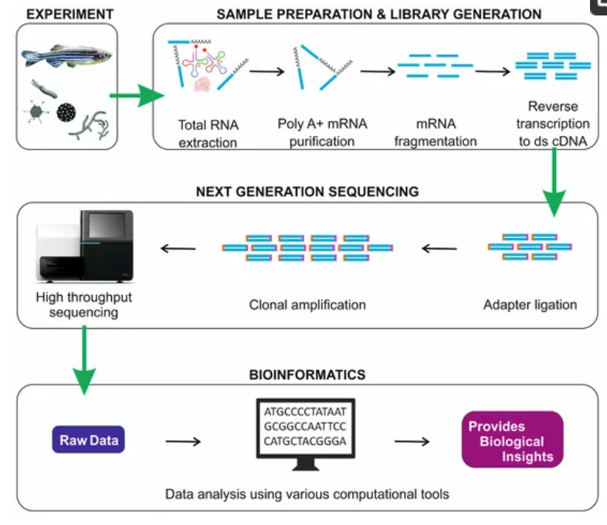
RNA-seq - overview
From https://doi.org/10.3390/ijms19010245

Slide 20
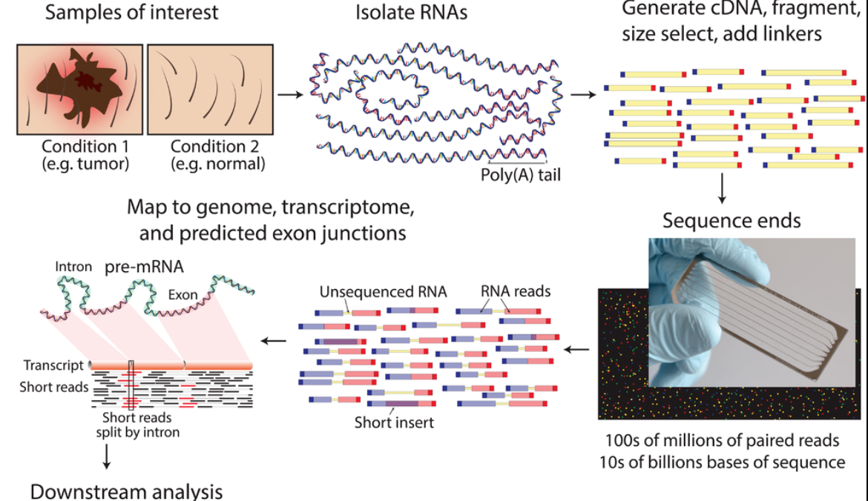
RNA-seq - experiment
https://www.wikiwand.com/en/RNA-Seq

Slide 21
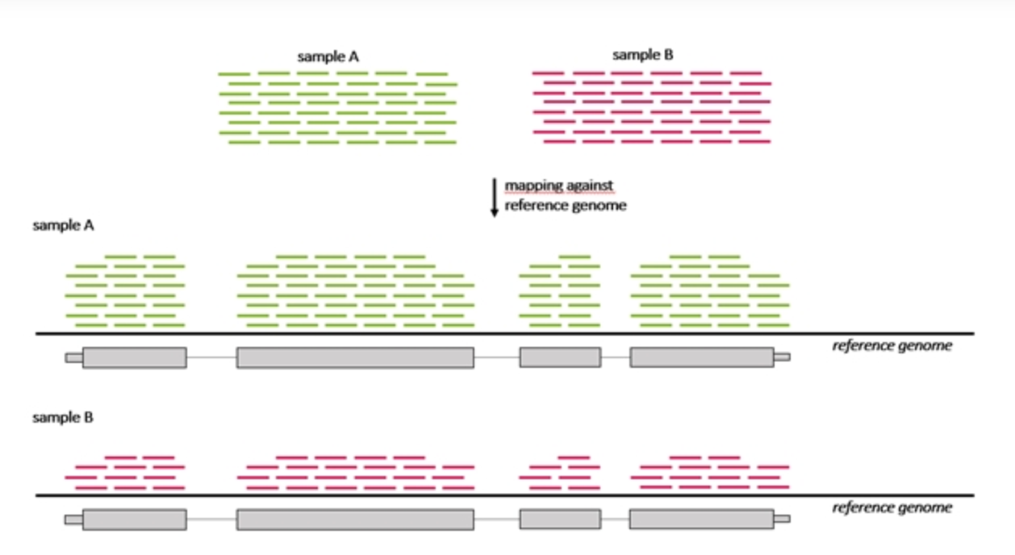
RNA-seq - differentially expressed genes (DGE)
Which genes are expressed at different levels between conditions (sample A and sample B)
Many steps to calculate the DGE between sample A and B
Source : seqme

Slide 22
RNA-seq - analysis workflow
Biological samples
Session 1: Concepts + Demo
Library preparation
Sequencer: Reads Fastq
Quality check
FastQC
Trimming
cutadapt
Quality check
FastQC
Session 2: Concepts + Demo
Alignment/Mapping
STAR
Quality check
Counting Reads
featureCounts
Quality check
DGE
Intermediate RNA-seq workshop
December 6-December 7, 2021
Please register!

Slide 23
How does each step of the technology work?

Slide 24
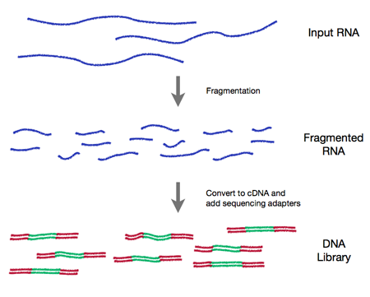
Isolation of RNA for library preparation
RNA quality is fundamental
RNA extraction method can affect the transcript abundance
Choice of platform and library preparation protocol
Meta-analysis of transcriptome datasets can introduce batches effects
K.R. Kukurba and S.B. Montgomery - RNA Sequencing and Analysis - Cold Spring Harbor Protocols
Notes:
Detailed information: https://rnaseq.uoregon.edu/#rna-prep-working-with-rna

Slide 25
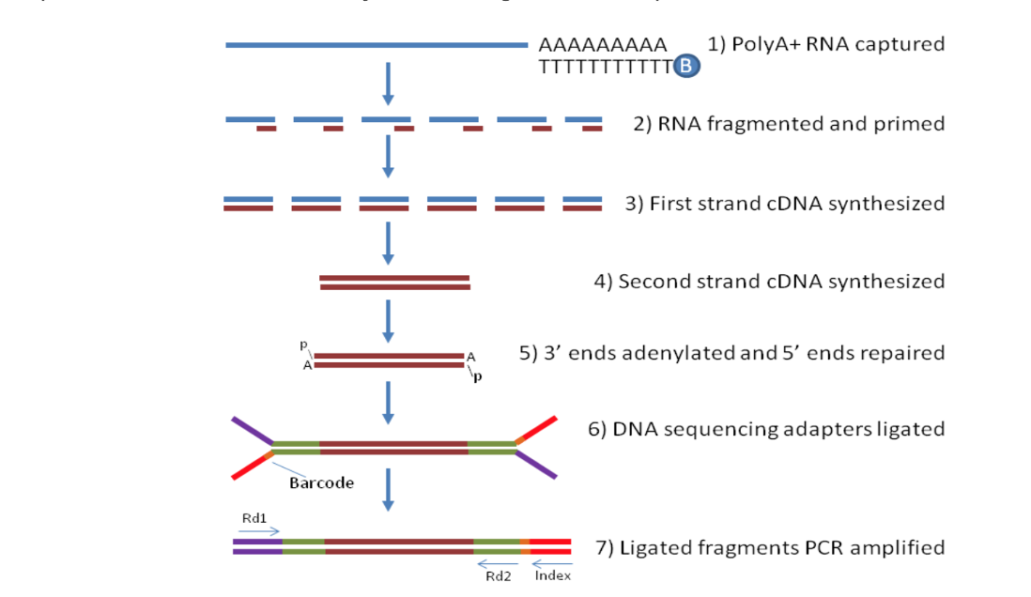
cDNA library preparation
Notes:
From http://rockefelleruniversity.github.io/RU_RNAseq/
More details here: https://rnaseq.uoregon.edu/#rna-prep-overview

Slide 26
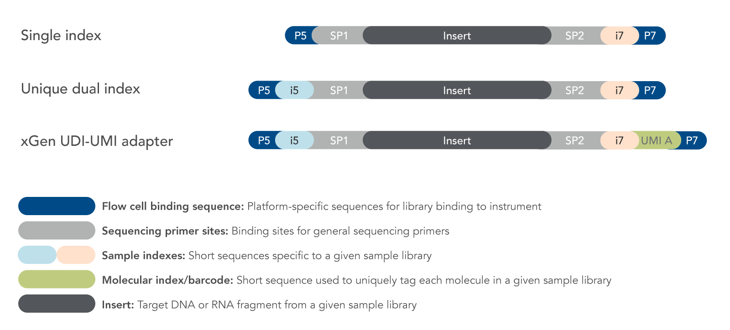
cDNA library preparation
Notes:
From http://rockefelleruniversity.github.io/RU_RNAseq/
More details here: https://rnaseq.uoregon.edu/#rna-prep-working-with-rna

Slide 27
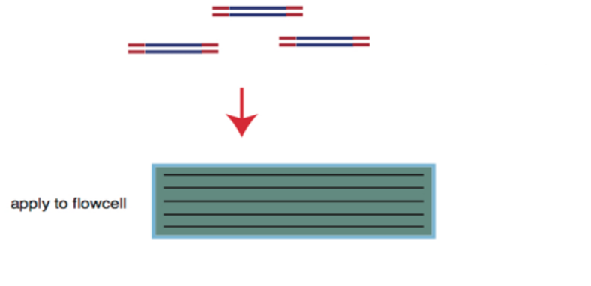
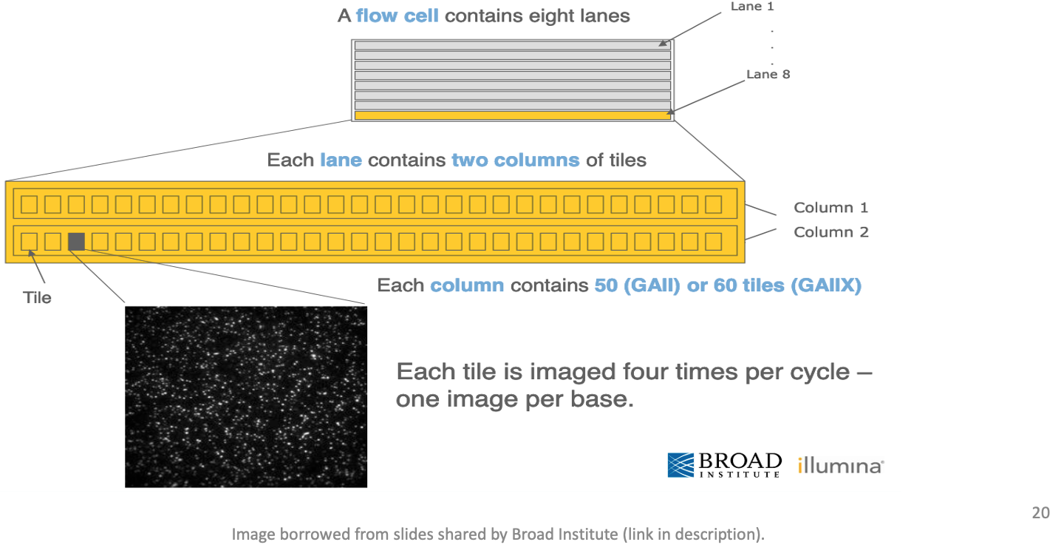
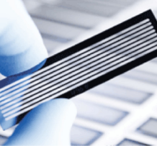
Flow cell organization for sequencing
cDNA library is applied to a flow cell
Notes:
From https://www.broadinstitute.org/files/shared/illuminavids/sequencingSlides.pdf

Slide 28
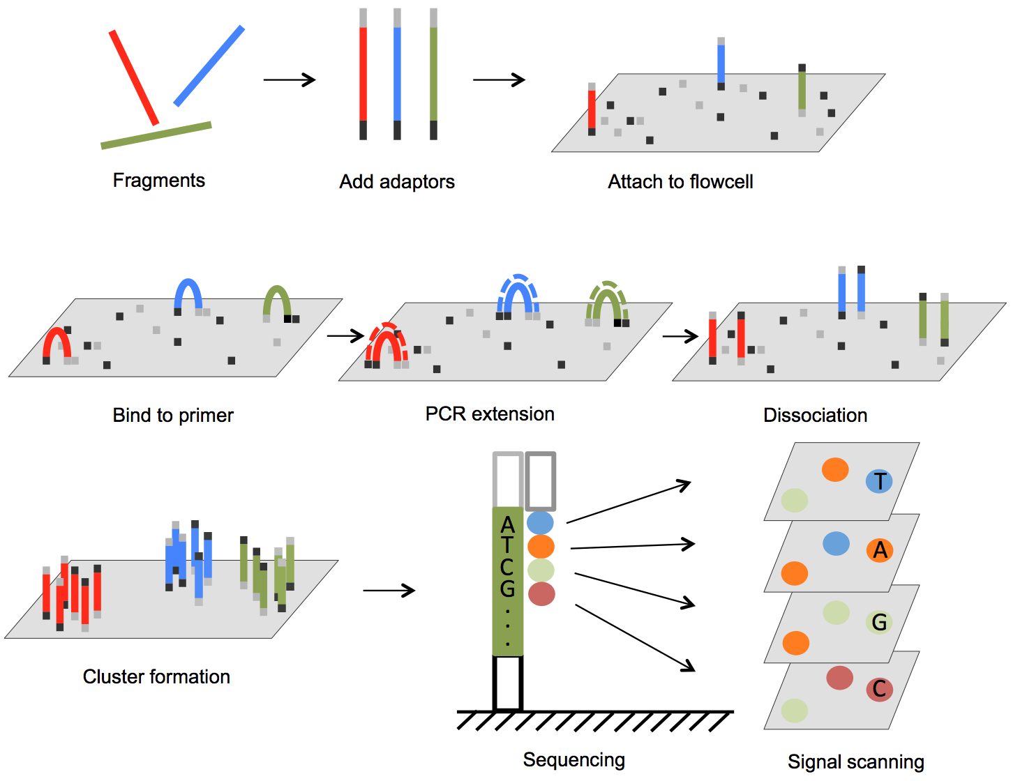
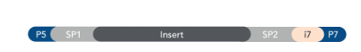

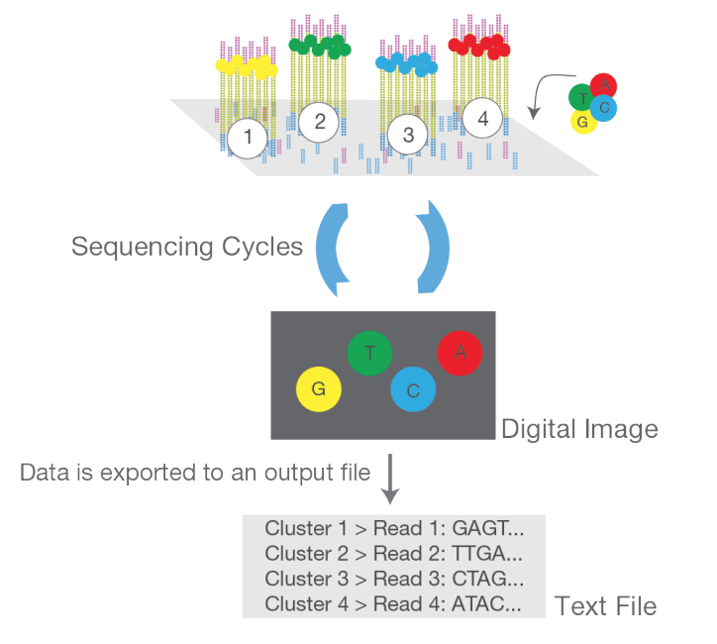

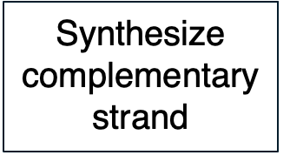

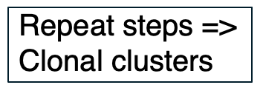
DNA fragments immobilized on flow cell & amplified into clonal clusters
ds cDNA > ss cDNA
From DOI: 10.5772/61657 and https://www.illumina.com/content/dam/illumina-marketing/documents/products/illumina_sequencing_introduction.pdf
Notes:
Cluster amplification: https://youtu.be/3URxJD5k3T8

Slide 29
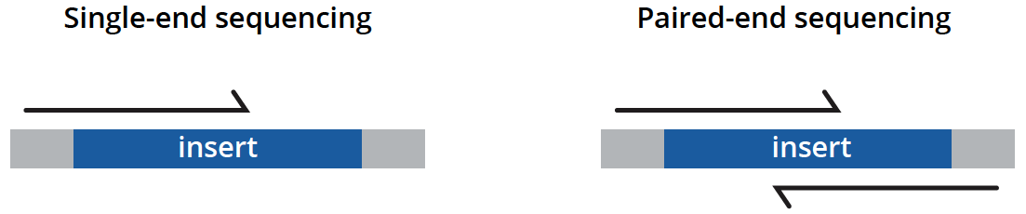
Types of sequencing
unidirectionally - sequencing from one end only
less expensive, is typically reserved for quantifying gene expression in well-annotated genomes and analyzing small RNA molecules.
bidirectionally - both ends of DNA fragments to be sequenced
usually recommended for most applications as it provides richer data and permits longer library insert sizes.
https://www.genewiz.com/
Notes:
Suggesting reading https://bmcbioinformatics.biomedcentral.com/articles/10.1186/s12859-020-3484-z

Slide 30
Poll
How are you feeling about the content covered so far?
Great - I am getting it
Okay - I am hanging in there
Wow - that is a lot of information
I need help

Slide 31
Break (10 min)
Galaxy registration and login
Need help - please drop a question in the chat or speak up

Slide 32

RNA-seq - analysis workflow
Biological samples
Session 1: Concepts + Demo
Library preparation
Sequencer: Reads Fastq
Quality check
FastQC
Trimming
cutadapt
Quality check
FastQC
Session 2: Concepts + Demo
Alignment/Mapping
STAR
Quality check
Counting Reads
featureCounts
Quality check
DGE

Slide 33
Example FASTQ file with one read only.
Open Single_read.fastq

Slide 34
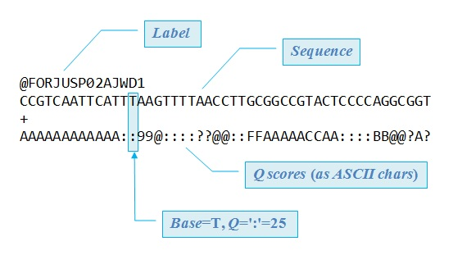
FASTQ files are text files with detailed information about each read.
Image adapted from Robert Edgar's web site https://www.drive5.com/

Slide 35
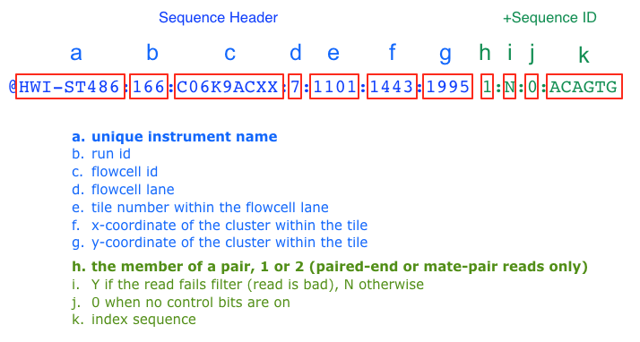
Label format in FastQ file
The more recent versions of Illumina software output a sample number (as taken from the sample sheet) in place of an index sequence (k).
Notes:
Suggested reading:
https://help.basespace.illumina.com/articles/descriptive/fastq-files/

Slide 36
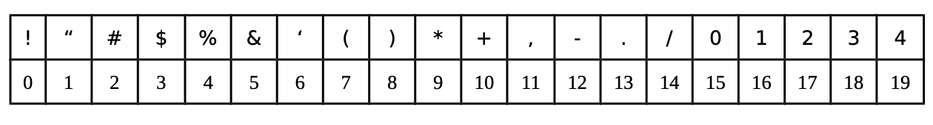
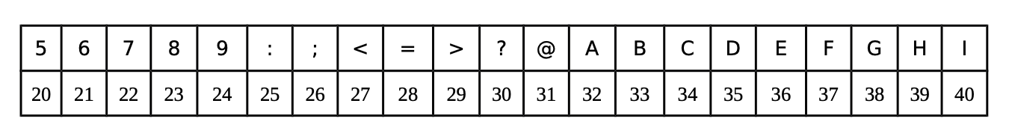
Quality score of each base
Each symbol is a probability p that the base call is incorrect.
The standard Sanger variant to assess reliability of a base call is Q=−10 log10(p)
Notes:
https://www.illumina.com/science/technology/next-generation-sequencing/plan-experiments/quality-scores.html

Slide 37
FASTQ files are text files with detailed information about each read.
Image adapted from Robert Edgar's web site https://www.drive5.com/

Slide 38
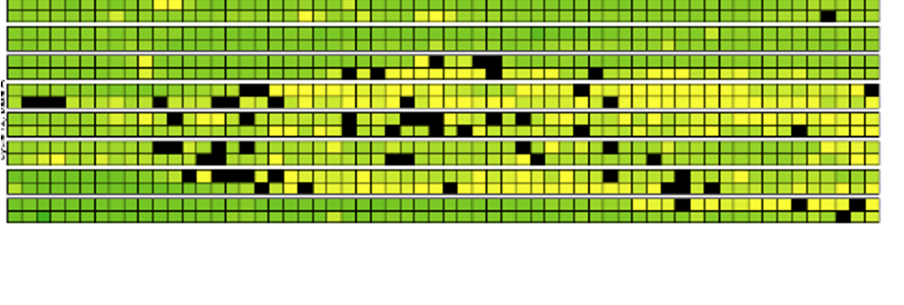
Base calling may not be accurate
Possible causes
Blocking of synthesis after one nucleotide addition may be inefficient.
Clusters might not be monoclonal.
A tile may be out of focus.
Oil, reagent, etc. on flow cell or imaging component, etc.
=> Need to record quality of each base call.

Slide 39
Naming conventions for fastq files
File names often follow a format.
SampleName_SampleNumber_LaneNumber_ReadNumber_SetNumber.fastq
Eg – Bacteria_S1_L001_R1_001.fastq
Paired-end reads named with R1 and R2 in file name.
Eg – Bacteria_GATTACA_L001_R1_001.fastq and Bacteria_GATTACA_L001_R2_001.fastq
File extensions may be .fq or even .txt.
Often compressed using gzip.
gzip is free and open-source.
Resulting file names have .gz added. Example – .fq.gz.
Notes:
File names samplename_S1_L001_R1_001.fastq.gz
samplename—The sample name provided in the sample sheet. If a sample name is not provided, the file name includes the sample ID, which is a required field in the sample sheet and must be unique.
S1—The sample number based on the order that samples are listed in the sample sheet starting with 1. In this example, S1 indicates that this sample is the first sample listed in the sample sheet.
L001—The lane number.
R1—The read. In this example, R1 means Read 1. For a paired-end run, there is at least one file with R2 in the file name for Read 2.
001—The last segment is always 001

Slide 40
Knowledge check
What is the flow cell id in the fastq file below?
@SIM:1:FCX:1:15:6329:1045 1:N:0:2
TCGCACTCAACGCCCTGCATA
+
<>;##=><9=AAAAAAAAA9#
15
FCX
#
SIM

Slide 41
Knowledge check
What is the Q-score (ASCII) of the 3rd base?
@SIM:1:FCX:1:15:6329:1045 1:N:0:2
TCGCACTCAACGCCCTGCATA
+
<>;##=><9=AAAAAAAAA9#
G
>
;
I
None of the above

Slide 42
RNA-seq - analysis workflow
Biological samples
Session 1: Concepts + Demo
Library preparation
Sequencer: Reads Fastq
Quality check
FastQC
Trimming
cutadapt
Quality check
FastQC
Session 2: Concepts + Demo
Alignment/Mapping
STAR
Quality check
Counting Reads
featureCounts
Quality check
DGE

Slide 43
FastQC: Quality check of sequencing data
Summarizes quality of base calls
Checks for presence of known adapters
Any sequences more frequently observed than expected?
Any sequence biases?
Any GC biases?
Notes:
For more: https://rtsf.natsci.msu.edu/genomics/tech-notes/fastqc-tutorial-and-faq/

Slide 44
Examples of FastQC reports
Good Illumina data: https://www.bioinformatics.babraham.ac.uk/projects/fastqc/good_sequence_short_fastqc.html
Bad Illumina data: https://www.bioinformatics.babraham.ac.uk/projects/fastqc/bad_sequence_fastqc.html

Slide 45
What if QC gives warn/fail flag?
Non-normal GC content per read?
Normal expected for whole-genome shotgun sequencing.
RNA-seq might give different distributions.
Non-uniform sequence content per nucleotide?
First 10-15 nt in RNA-seq often non-uniform.
High duplication levels or overrepresented sequences?
Are they contaminants, e,g. adapters or PCR duplicates?
If so, clean up contaminants.
Could be attributed to highly abundant transcripts.

Slide 46
Galaxy: Open source, web-based platform that integrates many tools.
Free, public, internet accessible resource.
https://usegalaxy.org/
Data transfer and data storage are not encrypted.
DO NOT UPLOAD PROTECTED DATA!!!

Slide 47
Dataset
Small dataset with 100k reads (for practice only).
FASTQ to tallying counts.
Analysis of real datasets can take time. Real sequenced read libraries can be found online https://www.ncbi.nlm.nih.gov/sra/.
The practice dataset has a low number of reads, which is not meaningful for differential gene expression analysis. Hence, for differential gene expression analysis use a real counts matrix, an example of which can be found at https://www.ncbi.nlm.nih.gov/geo/query/acc.cgi?acc=GSE49712.

Slide 48
Demo
Login to Galaxy
Uploading FASTQ files to Galaxy
Running FASTQC
Notes:
Steps:
1. Go to https://usegalaxy.org/login and login. Please make sure you activate your account before running the analysis. For activation, you should receive an email from Galaxy.
2. Click on “Upload data” option in the Tools panel on the left. In the window that opens, click on “Choose local files” and upload Bacteria_GATTACA_L001_R1_001.fastq to Galaxy by selecting it from your computer and pressing “Start”.
3. Search for the FASTQC tool in Galaxy using the Tools panel on the left.
4. Select FastQC from the options.
5. Under the “Short read data from your current history”, our uploaded data should be selected automatically.
6. Click on ”Execute”.
7. Since Galaxy is a freely available tool, it is used by many researchers around the world. It may take some time for the results to be available.
8. When the execution is finished, results will be visible (highlighted in green) in the History panel on the right. You can view them by clicking on the eye icon next to each resulting file name.
Similar steps of searching for tools in the left panel, viewing the intermediate results by clicking on the eye icon in the right-side History panel, and selecting data files as input in the central panel can be used for subsequent steps.
Suggested reading:
https://training.galaxyproject.org/training-material/topics/transcriptomics/tutorials/ref-based/tutorial.html

Slide 49
Session 1: Take-home messages
Define your hypothesis and datasets before planning RNA-seq experiment
Each steps of the analysis can be affected by some kind of bias - Check the quality after each step!
Be familiar with file formats
Biological samples
Library preparation
Sequencer: Reads Fastq
Quality check
FastQC
Trimming
cutadapt
Quality check
Session 2
Alignment/Mapping
STAR
Quality check
Please take the survey:
https://www.surveymonkey.com/r/F75J6VZ
Counting Reads
featureCounts
Quality check
DGE

Slide 50
Working material for this workshop
Single_read.fastq
Bacteria_GATTACA_L001_R1_001.fastq
Adapter_Sequence.fasta
rDNA_sequence.fasta
rDNA.gtf
all_steps.sh
Please register on Galaxy, activate account and login!
https://usegalaxy.org/login

Slide 51
Introduction to RNA-seq data analysis
Michela Traglia, Ayushi Agrawal
Bioinformatics Core, GIDB
October 14-15, 2021

Slide 52
Session 2
Tools: Galaxy, cutadapt, STAR, featureCounts

Slide 53
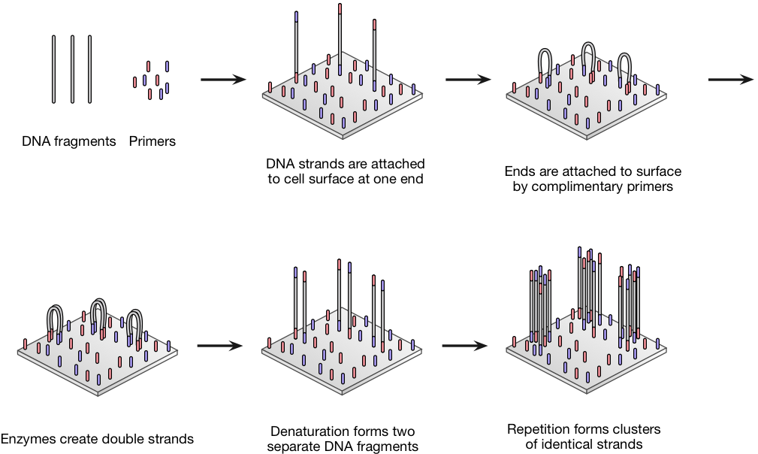
RNA-seq - overview
Single_read.fastq
Bacteria_GATTACA_L001_R1_001.fastq
From https://doi.org/10.3390/ijms19010245

Slide 54
Workshop outline
Session 1
Why studying the transcriptome and with which assay
Questions that we can answer with RNA-seq experiments
RNA-seq protocols in details
Break
Concepts and Demo with Galaxy: steps from raw data to FastQC
Session 2 (day2)
Concepts and Demo with Galaxy
From FastQC to Trimming
Mapping to reference genome
Break
Annotation to genomic features
Additional resources

Slide 55
Knowledge check
What is the sequence length reported by the FASTQC run yesterday?
100000
50
0

Slide 56
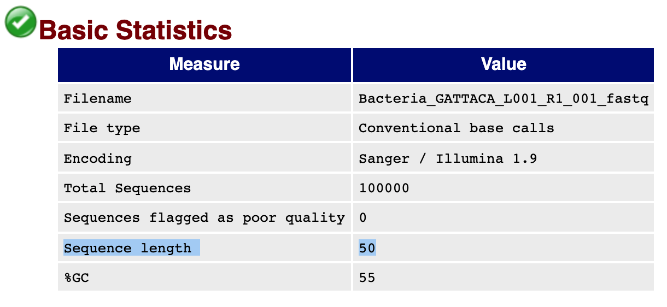
Knowledge check
What is the sequence length reported by the FASTQC run yesterday?
100000
50
0

Slide 57
RNA-seq - analysis workflow
Biological samples
Session 1: Concepts + Demo
Library preparation
Sequencer: Reads Fastq
Quality check
FastQC
Trimming
cutadapt
Quality check
FastQC
Session 2: Concepts + Demo
Alignment/Mapping
STAR
Quality check
Counting Reads
featureCounts
Quality check
DGE

Slide 58
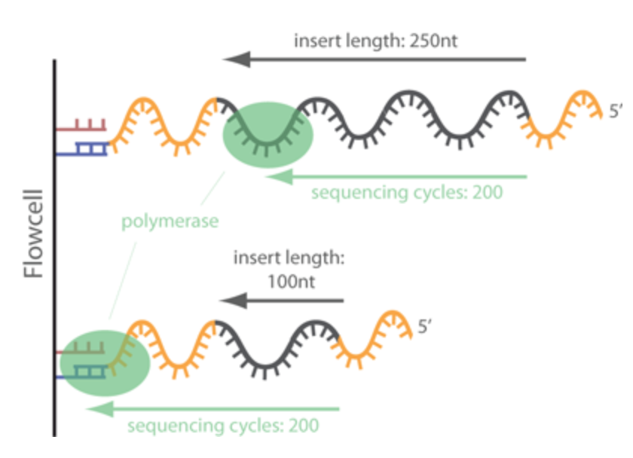
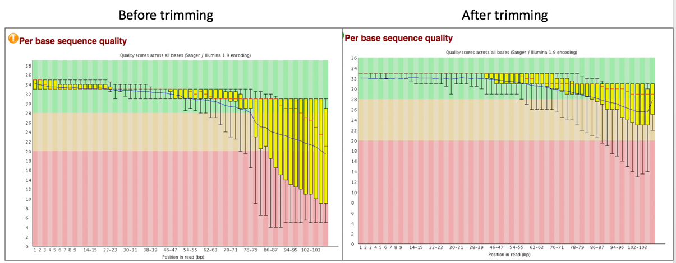
Trimming - Removing adapters
Tools: cutadapt, Trimmomatic

Slide 59
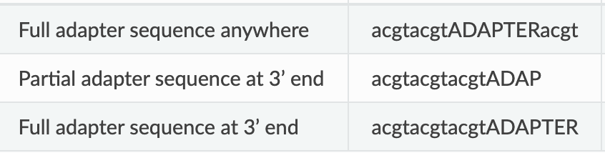
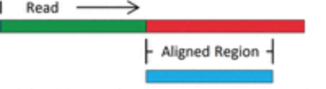

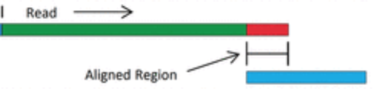
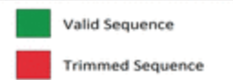
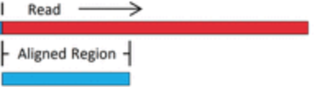

cutadapt removes adapters
Search for adapter sequence in read.
Allow for mismatches in sequence.
If significant alignment, cut.
5’
3’
5’
3’
Let’s run cutadapt on Galaxy!
Notes:
Steps:
1. 3’ prime adapter sequences are available in Adapter_Sequence.fasta. Upload it to Galaxy using the upload data button, which should be visible in the Tools panel at the top.
2. Search for cutadapt in the Tools panel on the left.
3. Under the “FASTQ/A file”, select the previously uploaded raw sequence file Bacteria_GATTACA_L001_R1_001.fastq.
4. Under the “Read 1 Options”, click on the button “+ Insert 3' (End) Adapters”. Under source, select “File from history” and under “Choose file containing 3' adapters” select the Adapter_Sequence.fasta.
5. In “Filter Options”, for “Minimum length”, enter 20.
6. In “Read Modification Options”, for “Quality cutoff”, enter 20.
7. In “Output Options”, check “Yes” for “Report”
8. Click Execute.

Slide 60
RNA-seq - analysis workflow
Biological samples
Session 1: Concepts + Demo
Library preparation
Sequencer: Reads Fastq
Quality check
FastQC
Trimming
cutadapt
Quality check
FastQC
Session 2: Concepts + Demo
Alignment/Mapping
STAR
Quality check
Counting Reads
featureCounts
Quality check
DGE

Slide 61
Redo QC to ensure satisfactory quality
Run FastQC.
Is the adapter content gone?

Slide 62
RNA-seq - analysis workflow
Biological samples
Session 1: Concepts + Demo
Library preparation
Sequencer: Reads Fastq
Quality check
FastQC
Trimming
cutadapt
Quality check
FastQC
Session 2: Concepts + Demo
Alignment/Mapping
STAR
Quality check
Counting Reads
featureCounts
Quality check
DGE

Slide 63
Alignment/Mapping
Aligning reads to regions of reference DNA.
Assumption: After cleaning, reads from real sample only.
Strategies for assembly:
Reference genome
De novo assembly
Tools: STAR, HISAT2, TopHat2, bowtie2, salmon, kallisto

Slide 64
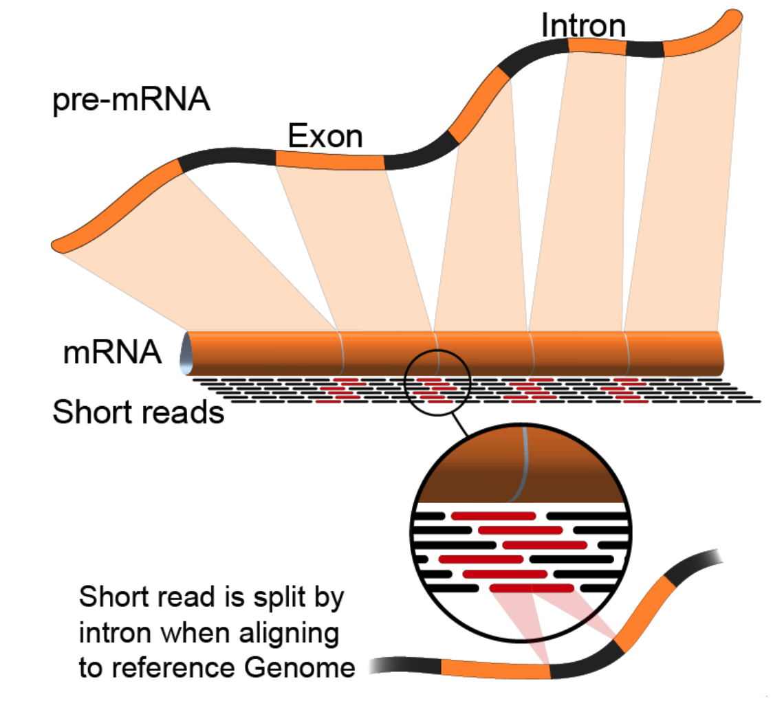
Alignment to genome : challenges
Reads from junctions: one part of it maps to one exon and the other half maps to the other exon
Reference sequences can be very long (~3 billion bp for humans).
Order of 100 million reads to be mapped.
Need to account for splicing.
Allow for PCR artifacts/sequencing errors.
Notes:
Suggested reading:
https://www.ncbi.nlm.nih.gov/pmc/articles/PMC3322381/pdf/nihms-366740.pdf
https://academic.oup.com/bioinformatics/article/29/1/15/272537
Video lectures on how these mapping tools work:
https://www.youtube.com/watch?v=hpb-mH-yjLc&list=PL2mpR0RYFQsBiCWVJSvVAO3OJ2t7DzoHA

Slide 65
Alignment/Mapping: STAR tool
STAR is popular for RNA-Seq data because it
does unbiased de novo detection of canonical junctions
can discover non-canonical splices
can discover chimeric (fusion) transcripts

Slide 66
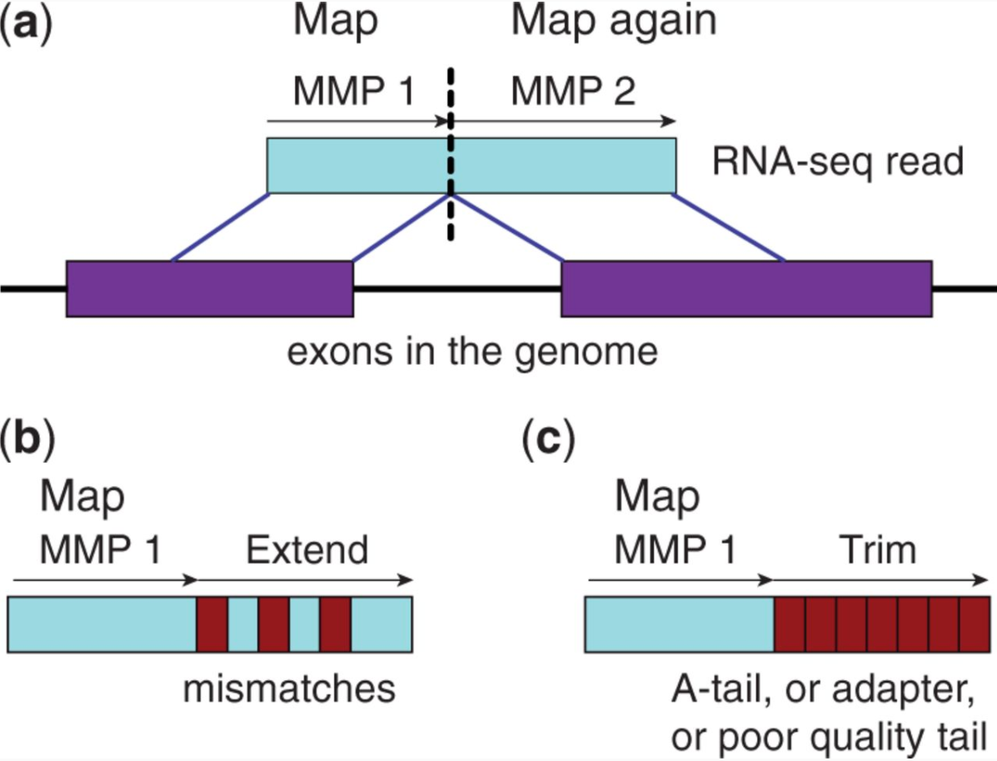
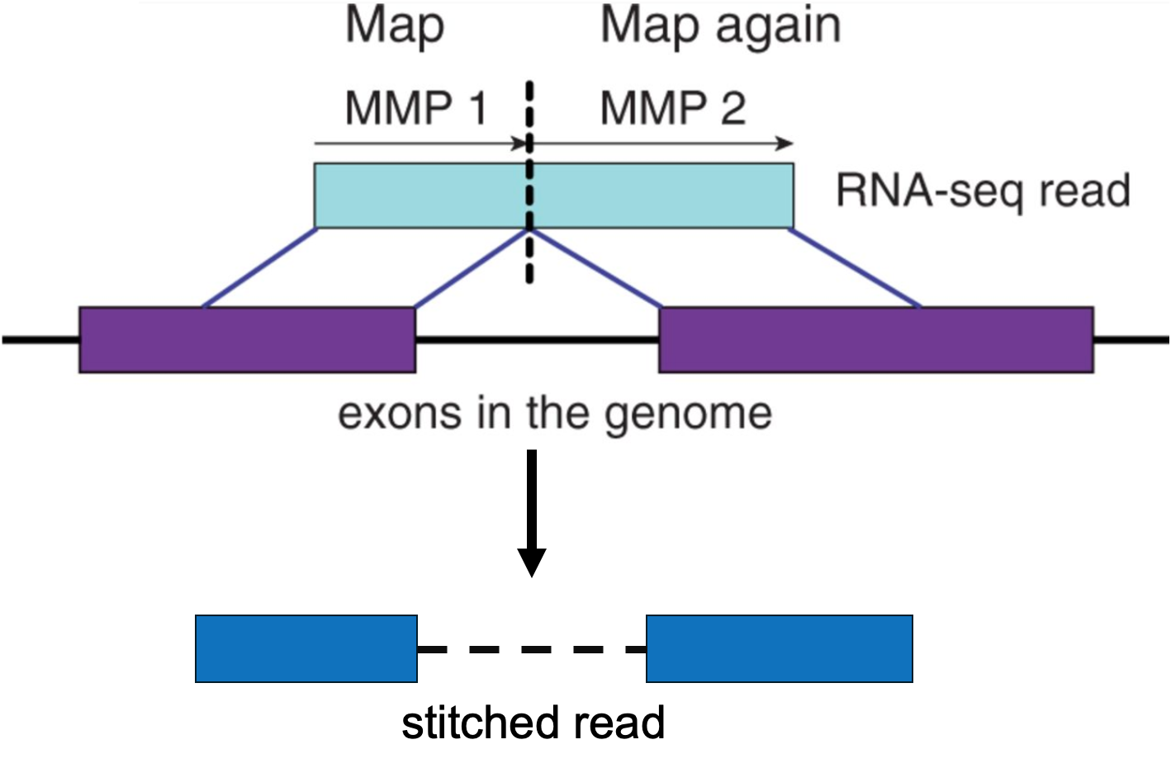
Alignment/Mapping: How does STAR work?
Step 1: Seed search
Step 2: Stitching and scoring
MMP = Maximum Mappable Prefix
Image source: STAR's seed search (Figure 1 from Dobin et al. 2013)

Slide 67
Alignment/Mapping: Inputs needed
Reads to align.
FASTQ file after cleaning (trimming adapters).
Reference sequence to align to.
Example – “rDNA_sequence.fasta”
FASTA format. Two lines per sequence.
Starting with “>”, followed by sequence name/identifier.
Sequence.
File extensions: .fasta, .fa, .txt.
Examples of acceptable genome sequence files for STAR:
ENSEMBL: files marked with .dna.primary.assembly
GENCODE: files marked with PRI (primary). Strongly recommended for mouse and human.
Notes:
Examples of acceptable genome sequence files:
ENSEMBL: files marked with .dna.primary.assembly, such as: ftp://ftp.ensembl. org/pub/release-77/fasta/homo_sapiens/dna/Homo_sapiens.GRCh38.dna.primary_ assembly.fa.gz
GENCODE: files marked with PRI (primary). Strongly recommended for mouse and human: http://www.gencodegenes.org/.

Slide 68
Poll
How is the pace?
Too fast - please go slower
Just right - keep going at the same pace
Too slow - please go faster

Slide 69
Demo with STAR on Galaxy
Notes:
Steps:
1.Search for RNA STAR in Tools panel on the left.
2.Upload rDNA_sequence.fasta to Galaxy using the load data icon, which should be visible in the Tools panel at the top.
3.Use the output from cutadapt as input under the field “FATA/Q file” in the central panel.
4.Under “Will you select a reference genome from your history or use a built-in index?” select “Use a genome from history and build index”. Then, select rDNA_sequence.fasta as “the reference genome” in the next field.
5. Press Execute.
6.The output should be available as a SAM or BAM file.

Slide 70
Break (10 min)
Need help? Please drop a question in the chat or speak up
Please take the survey:
https://www.surveymonkey.com/r/F75J6VZ

Slide 71
Understanding STAR output
1. Alignments in SAM format
2. Summary of mapping statistics
How many reads mapped?
How many unmapped?
...

Slide 72
Sequence Alignment/Map (SAM) format
Open with Excel.
First few lines contain metadata about alignments.
These lines start with “@”.
Example – version of file format, sorting order of alignments, grouping, etc.
After header, a table of alignments.
Alignment reports often very large files.
Binary Alignment/Map (BAM) extension used for compressed SAM files.
Notes:
Suggested reading:
https://samtools.github.io/hts-specs/SAMv1.pdf

Slide 73
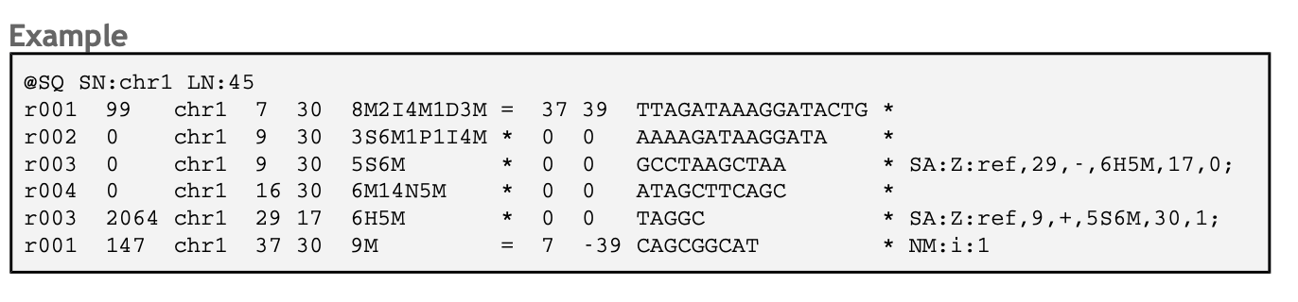
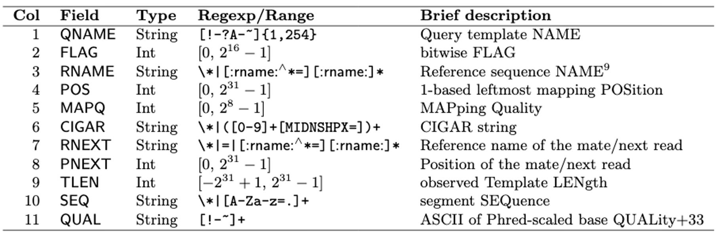
SAM format
Notes:
Suggested reading:
https://samtools.github.io/hts-specs/SAMv1.pdf
https://broadinstitute.github.io/picard/explain-flags.html

Slide 74
RNA-seq - analysis workflow
Biological samples
Session 1: Concepts + Demo
Library preparation
Sequencer: Reads Fastq
Quality check
FastQC
Trimming
cutadapt
Quality check
FastQC
Session 2: Concepts + Demo
Alignment/Mapping
STAR
Quality check
Counting Reads
featureCounts
Quality check
DGE

Slide 75
Knowledge check
Which information do you find in a SAM/BAM file?
Sequences, like a FASTQ file
Location of the read on the chromosome
Mapping quality
All of the above

Slide 76
Knowledge check
Which information do you find in a SAM/BAM file?
Sequences, like a FASTQ file
Location of the read on the chromosome
Mapping quality
All of the above

Slide 77
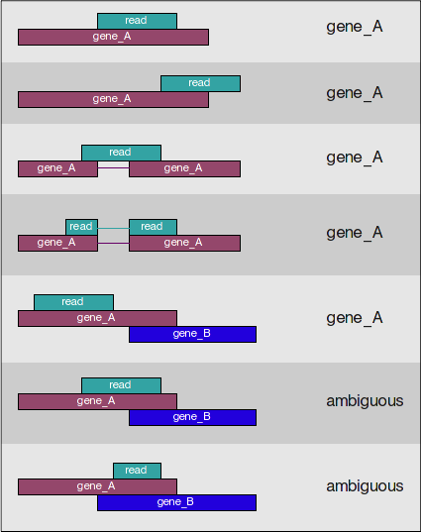
How many reads overlap annotated regions?
Need annotation information
Need alignment information
Use featureCounts
Notes:
Suggested reading:
https://academic.oup.com/bioinformatics/article/30/7/923/232889

Slide 78
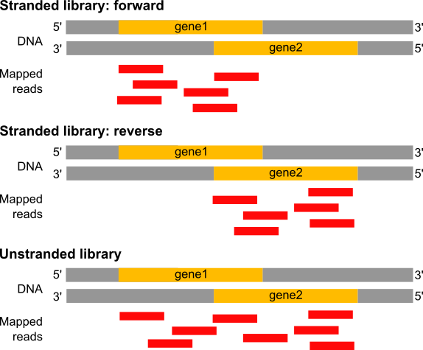
Estimation of the strandness
In a stranded forward library, reads map mostly on the genes located on forward strand (here gene1).
With stranded reverse library, reads map mostly on genes on the reverse strand (here gene2).
With unstranded library, reads maps on genes on both strands.
Image source: https://training.galaxyproject.org/training-material/
Notes:
Suggested reading:
https://www.ncbi.nlm.nih.gov/pmc/articles/PMC3005310/

Slide 79
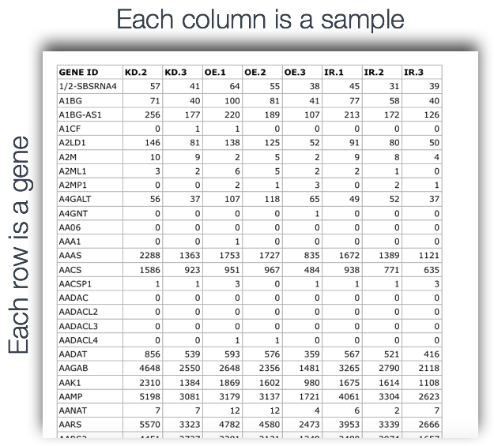
featureCounts input/output
Input:
BAM file
GTF file
Output:
count matrix (text file)
a summary file
Notes:
Steps:
1.Search for featureCounts in Tools panel.
2.Upload rDNA.gtf to Galaxy as described before.
3.Under Alignment file, select the STAR SAM file output.
4.For Gene Annotation file, select “in your history”.
5.Then, select rDNA.gtf as the input for Gene Annotation file.
6. In “Advance options”, for “GFF feature type filter”, type CDS.
7. Click Execute

Slide 80
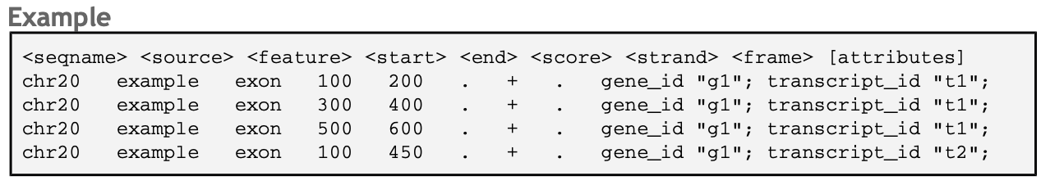
Annotation GTF format
Gene Transfer Format

Slide 81
RNA-seq - analysis workflow
Biological samples
Session 1: Concepts + Demo
Library preparation
Sequencer: Reads Fastq
Quality check
FastQC
Trimming
cutadapt
Quality check
FastQC
Session 2: Concepts + Demo
Alignment/Mapping
STAR
Quality check
Counting Reads
featureCounts
Quality check
DGE

Slide 82
RNA-seq - differentially expressed genes (DGE)
Which genes are expressed at different levels between conditions (sample A and sample B)
Many steps to calculate the DGE between sample A and B
Source : seqme

Slide 83
Gene-wise counts should be normalized before comparing between samples
Library size: counts can differ because of different library sizes (Sample A and Sample B)
Real change in expression level of a gene vs non-biological reasons
Need to estimate variability (dispersion)
Several steps and specific tools
Intermediate RNA-seq workshop
December 6-December 7, 2021
Please register!

Slide 84
Session 2 - Take-home messages
Each steps of the analysis can be affected by some kind of bias - Check the quality after each step!
Be aware of possible batch effects, non biological variability.
Know the tools and how they work. Use best practices for the analysis.
This workshop covered:
Common tools, e.g., fastqc, cutadapt, STAR
Common file formats, e.g., FASTQ, FASTA, SAM, GTF, BAM
Analysis with Galaxy

Slide 85
Real data is complex
This workshop provides an introduction to typical RNA-seq analysis steps using an artificial dataset. Real data might need additional analyses choices.
Possible challenges with real data: (What we did not cover today)
What to do you if only 50%of reads align to reference?
What to do if FastQC reports unusual GC content?
What to do if the reference genome is incomplete?
How to deal with more complicated experimental designs?
How many replicates to use for RNA-seq?
Some analysis choices need experience. Consult with the Gladstone Bioinformatics core for such scenarios and data.
Notes:
E.g: The argument choices available for STAR

Slide 86
Thank you!
Please take the survey:
https://www.surveymonkey.com/r/F75J6VZ
Other resources
RNA-seq and analysis
RNA-seq review
RNA-seqlopedia
Galaxy tutorial

Slide 87
Upcoming workshop at Gladstone:
October 14-15 | Introductory RNA-seq
October 19 | Graph Database
October 22,25-26 | Single Cell RNA-Seq Session 1-4
November 1 | Introductory Machine Learning for biologists
November 9 | Advanced Cytoscape Using R
November 19 | Whole Genome Sequence Analysis
November 30 | Experimental Designs
December 3 | Intermediate R: Data Visualization
December 6-7 | Intermediate RNA-Seq analysis Using R
Data Science Training Program

Slide 88


